Slide 1

WEEK 01
Instructor: Yanan Wu
TA: Vanchy Li
Spring 2025

Slide 2
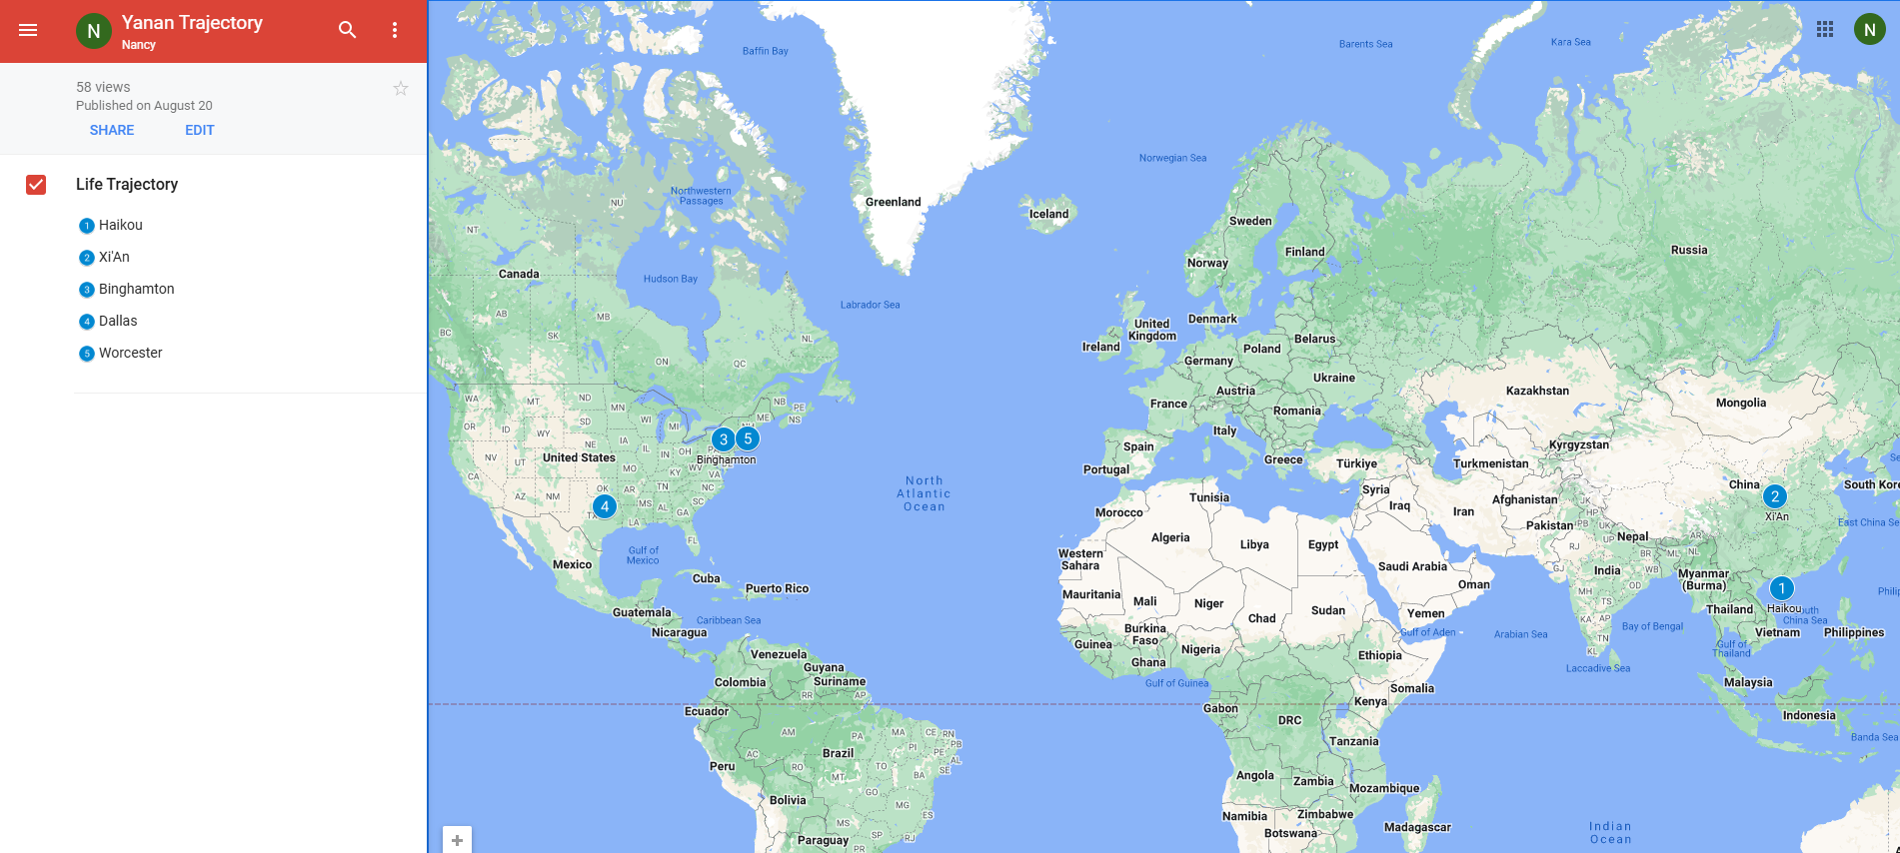
Yanan wu – visiting assistant professor
Education & Experience

Slide 3






Python Programming
Spatial Database
Intermediate Statistics
Manipulating Spatial Data
Web Mapping
Processing Raster
Data Analysis
Creating Custom Tool
Data Visualization
…
Geodatabase
SQL
Proximity Analysis
Geometry processing
Raster processing
PostSQL with python
…
Bivariate regression
Logistics regression
PCA
GWR
Spatial Autocorrelation
…

Slide 4
Instructor office hour
Tuesday & Thursday
1:30 pm – 2: 30 pm Or By appointment
Office Location: Jeff 220

Slide 5
Ta introduction
Office Hours: 1: 00 – 3:00 PM on Monday
Office Location: EROS, the first floor of the Geography Building.

Slide 6
How about you?
Your background (e.g., name, major, where you come from)
What is your funniest thing that happened during your winter break?
What relevant experience do you have with spatial database?
What are your expectations for this course?

Slide 7
Course format
Lectures: Instructor & TA
Location:
10:25 – 11:40 on Monday, Physics/Math BP310
14:50 – 16:40 on Tuesday, Jonas Clark Hall JC105
Labs: TA
Location: Physics/Math BP310
Time: 10:25 – 11:40 on Friday

Slide 8
learning resource
Introduction to PostGIS
Welcome to PostGIS Book
Other Training Materials
Official Manual about PostGIS
Obe, R., & Hsu, L. S. (2021). PostGIS in action. Simon and Schuster.

Slide 9
Course requirements
Labs: 9 labs in total
For any graded assignment, if the you do not agree with the grade received, the instructor and TA must be notified within one week after the assignment is graded.
Late policy for lab
Final project (oral presentation and paper report)

Slide 10
gRADE
Assignments 80% = nine labs
Final Project 20% = 15% oral + 5% written
A (93.0 to 100.0) | B (83.0 to 86.9) | C (73.0 to 76.9) | D (63.0 to 66.9)
A- (90.0 to 92.9) | B- (80.0 to 82.9) | C- (70.0 to 72.9) | D- (60.0 to 62.9)
B+ (87.0 to 89.9) | C+ (77.0 to 77.9) | D+ (67.0 to 69.9) | F (0.0 to 59.9)

Slide 11
Important dates
Jan 22. Add/Drop ends (& last day to request audit) Full Semester
No class
Jan 20. University holiday
Feb 17. Wellness day
March 3-7 Spring Break
March 24-27 AAG Conference
Final project
April 14-24 Working on final project
April 28 – May 1 Final project presentation
May 5 Final report due

Slide 12




COURSE WEBSITEs ON GITHUB
Intermediate Statistics
Spatial Database
Python Programming
Web Mapping

Slide 13

GIS HELP DESK
NEW SPRING 2025 HOURS:
Need help with GIS? Can't make it to visit your professor or TA for office hours? Stop by our GIS Help Desk in the Jefferson Tower (6th floor), or in Jefferson 220A (2nd floor Jefferson building, Geog Main office) on Wednesdays, and visit one of our Help Desk Assistants!
MONDAYS
TUESDAYS
WEDNESDAYS @ JF220A
THURSDAYS
FRIDAYS
SASHA 9 AM - 11 AM
SASHA 9 AM - 12 PM
SASHA 9 AM - 12 PM
WYNNIE 2 PM - 5 PM
WYNNIE 2 PM - 5 PM
WYNNIE 3 PM - 5 PM
GIS Help Desk hours follow a University schedule. If the University is closed from remote/online operations for any reason, the GIS Help Desk may also be unavailable. GIS Help Desk Assistants operate on a first-come, first-serve drop-in basis. Contact Marjorie Miller (marmiller@clarku.edu) with any questions, or call the Geography Main Office at 508-793-7336 for more information. The GIS Help Desk is sponsored by the Graduate School of Geography at Clark University.

Slide 14


Spring 2025 hours
GIS Help Desk
Please contact either of our GIS Help Desk Assistants during their specified hours for more information.
SASHA GANNON| GEOG ’24 MS-GIS ‘25
WYNNIE GROSS| GEOG ’24 MS-GIS ‘25
MONDAYS 9AM – 11AM
TUESDAYS 9AM – 12PM WEDNESDAYS* 9AM –12PM
WEDNESDAYS*
3PM – 5PM
THURSDAYS
2PM – 5PM
FRIDAYS
3PM – 5PM
Help Desk hours follow a University schedule. If the University is closed (or if the Geography office is closed), the GIS Help Desk will be unavailable. Hours may be limited or extended during midterms/final exams. Any changes will be announced or posted on the Clark University Geography Facebook page. Appointments operate on a first-come, first-serve drop-in basis unless otherwise scheduled.
508.793.7336 | Jefferson Tower, 6th Floor; *Wednesdays are in Jefferson 220A, Geog Main Office, Jefferson Building, 2nd Floor*

Slide 15
WEEK 01 lecture session
Instructor: Yanan Wu
TA: Vanchy Li
Spring 2025

Slide 16

Week 01
Introduction to the Course
Software Installation
PostgreSQL: The world’s most advanced open source database
PostGIS: About PostGIS

Slide 17

Week 02
Introduction to the PostGIS, PostgreSQL, and pgAdmin
Basic operations in pgAdmin
Introducing PostGIS
Introduction to psql

Slide 18
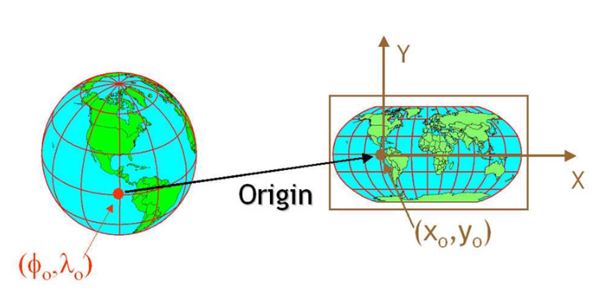
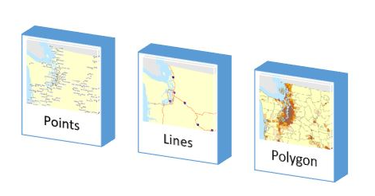
Week 03
Spatial data and geodatabases
Spatial data types
Spatial reference systems
Working with real data

Slide 19

Week 04
Introduction to SQL (It is pronounced as “Escuel “, but most often you can hear the slang “Sequel”.)
Simple SQL
SELECT
INSERT
UPDATE
DELETE
Working with spatial data

Slide 20
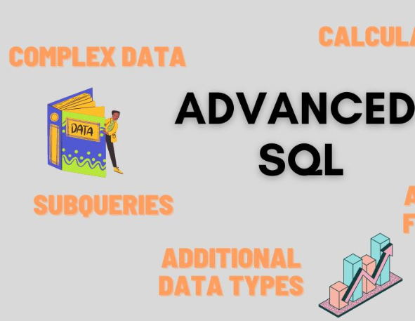
WEEK 05
Complex Queries and Database Management
Combine Information
Write Queries to run faster and use less data

Slide 21
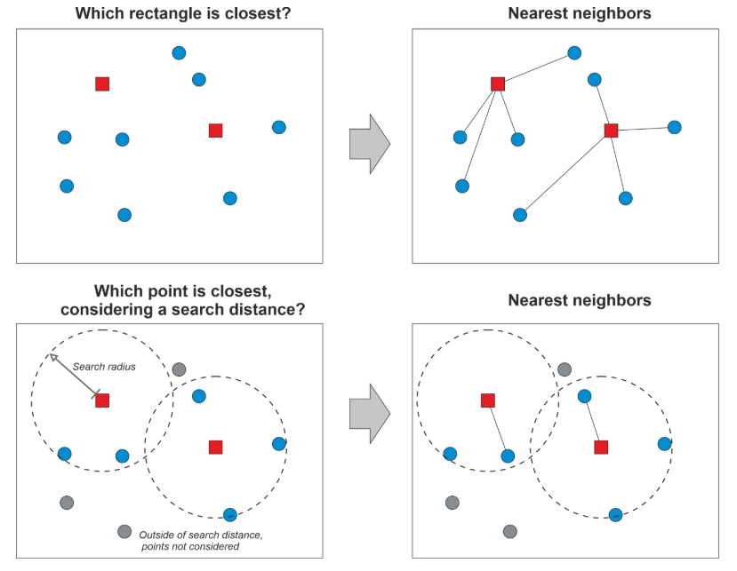
Week 06 & week 07
Proximity Analysis
Nearest Neighbor Search

Slide 22

WEEK 08
No Class Meeting
Spring Break

Slide 23
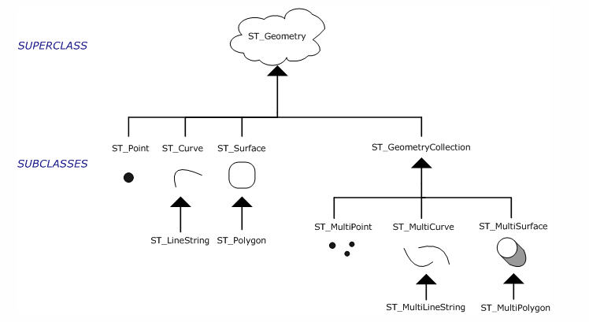
Week 09
Geometry processing

Slide 24
Week 10
Raster Processing
Raster output
Raster Accessors and setters
Reclassing functions

Slide 25

Week 11

Slide 26



Week 12
PostgreSQL and ArcGIS or QGIS

Slide 27

WEEK 13
PostGIS with Python
Week 14
PostGIS in Web Application

